Slide 1
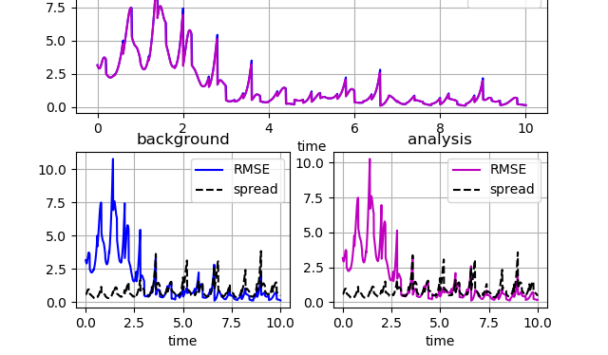
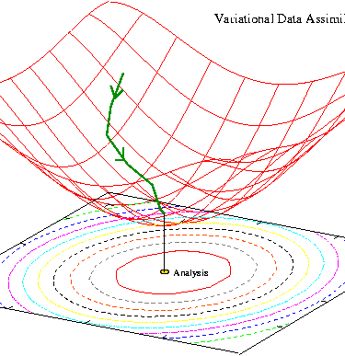
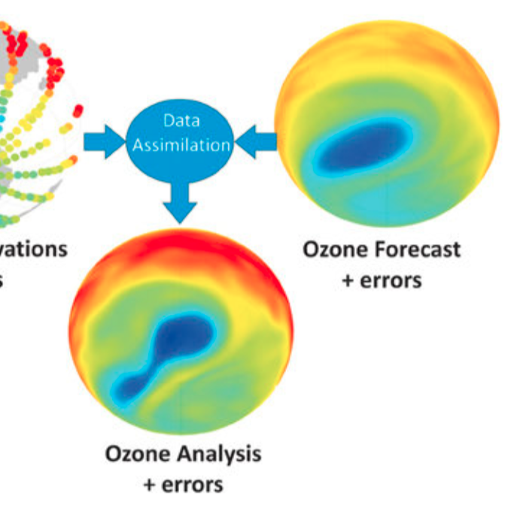
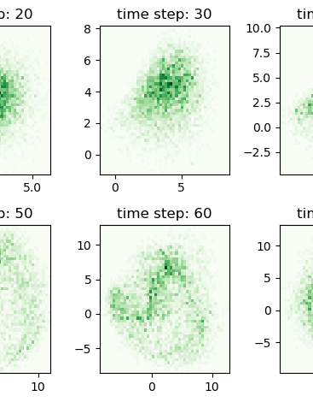
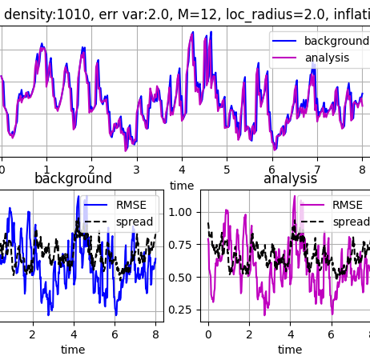
Overview of DA algorithms
Alison Fowler
Notes:
1.15hr

Slide 2
Aim of lecture
Give an overview of the different approaches to solving the data assimilation problem by building on a common framework.
Introduce the frequently used terminology
Highlight the similarities and differences between the different approaches.
More detailed descriptions of the algorithms will be presented in the rest of the week.

Slide 3
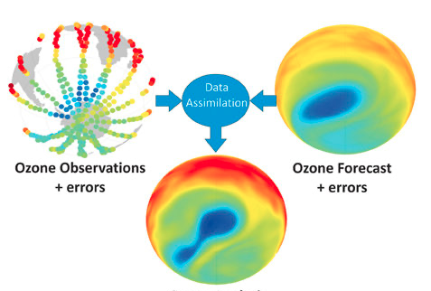
Recap aims of DA
The DA problem is to combine prior knowledge and relevant observations to give an updated estimate of the state of the atmosphere/oceans/land surface etc.
To initialize a forecast – the better the initial conditions the better the forecast.
Create reanalyses to understand the recent past.
Estimate parameters in the model to give a better understanding of the processes represented.
DA( , ) = )=
The prior e.g. discretised model and uncertainties
Observations and uncertainties
Updated estimate e.g. discretised analysis

Slide 4
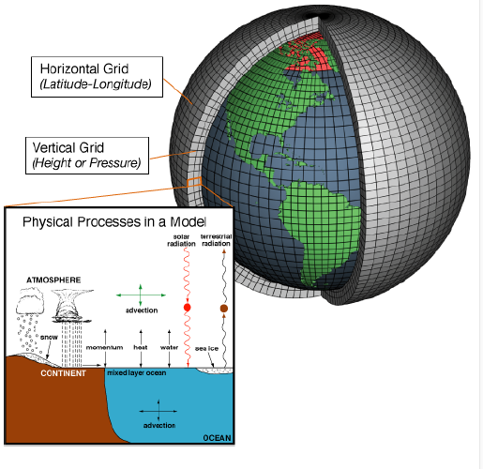

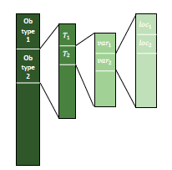
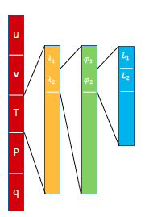

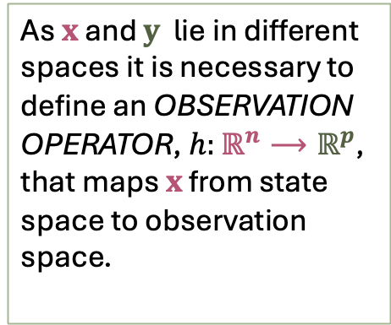
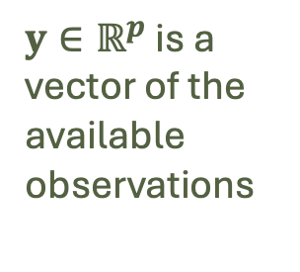
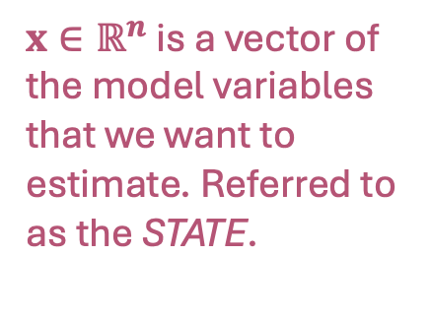
Linking observations to models
$x∈ℝ^{n}$ is a vector of the model variables that we want to estimate. Referred to as the STATE.
As $x$ and $y$ lie in different spaces it is necessary to define an OBSERVATION OPERATOR, $h:$ $ℝ^{n}⟶ℝ^{p}$, that maps $x$ from state space to observation space.
$y∈ℝ^{p}$ is a vector of the available observations

Slide 5
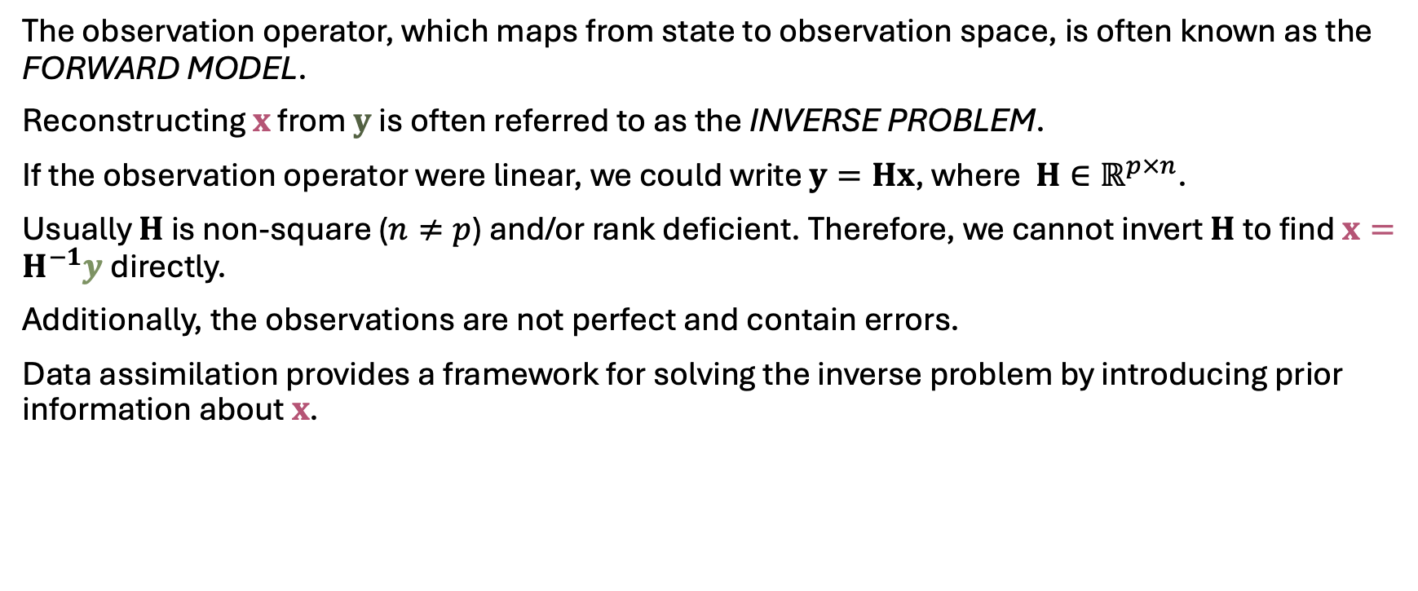
The inverse problem
The observation operator, which maps from state to observation space, is often known as the FORWARD MODEL.
Reconstructing $x$ from $y$ is often referred to as the INVERSE PROBLEM.
If the observation operator were linear, we could write $y=Hx$, where $H∈ℝ^{p×n}$.
Usually $H$ is non-square ($n≠p$) and/or rank deficient. Therefore, we cannot invert $H$to find $x=H^{−1}y$directly.
Additionally, the observations are not perfect and contain errors.
Data assimilation provides a framework for solving the inverse problem by introducing prior information about $x$.

Slide 6
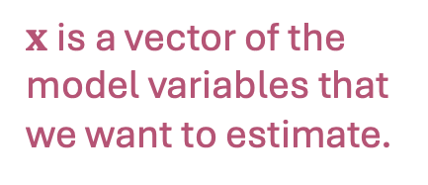
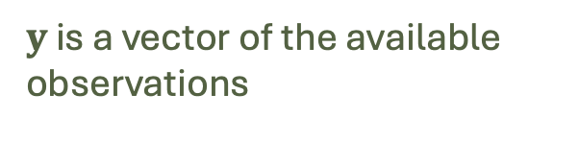

Bayes’ theorem
Most DA algorithms can be derived from Bayes’ theorem:
$$p\left(x | y\right)=\frac{p\left(x\right)p(y|x)}{p(y)}$$
prior
likelihood
posterior
marginal
$x$ is a vector of the model variables that we want to estimate.
$y$ is a vector of the available observations

Slide 7
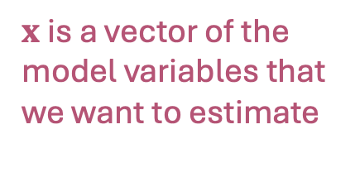

Bayes’ theorem
Most DA algorithms can be derived from Bayes’ theorem:
$$p\left(x | y\right)∝p\left(x\right)p(y|x)$$
posterior
prior
likelihood
$x$ is a vector of the model variables that we want to estimate
$y$ is a vector of the available observations

Slide 8
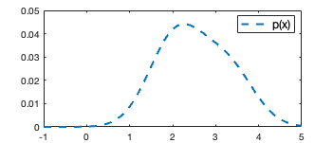
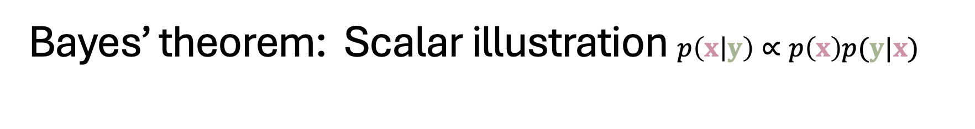
Bayes’ theorem: Scalar illustration $p\left(x | y\right)∝p\left(x\right)p(y|x)$
The prior PDF, p(x), describes the probability of your state variables. Often, this knowledge comes from a previous forecast.

Slide 9
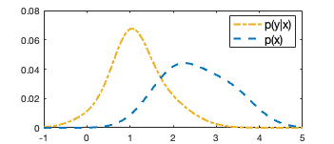
Bayes’ theorem: Scalar illustration $p\left(x | y\right)∝p\left(x\right)p(y|x)$
Likelihood PDF, p(y|x), describes the probability of observations given that they are measuring the state we are interested in. P(y|x)=L(x|y) so that we can think of it as a function of x.

Slide 10
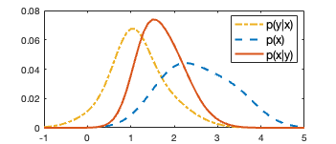
Bayes’ theorem: Scalar illustration $p\left(x | y\right)∝p\left(x\right)p(y|x)$
The posterior PDF is given by multiplying the two together and normalising. Updating the prior with information from the observations has shifted the probability mass and reduced the range of probable values of x (i.e. the uncertainty in x is reduced!)

Slide 11
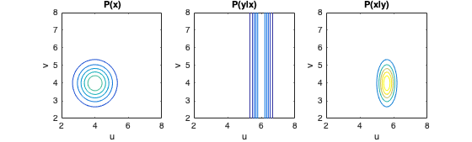
Bayes’ theorem: 2 variable example
Let our state x be a vector of zonal and meridional winds, u and v at one location. Observe u only.
Compared to the Prior, the region of high probability in the Posterior for u is reduced and is shifted towards that of the likelihood.

Slide 12
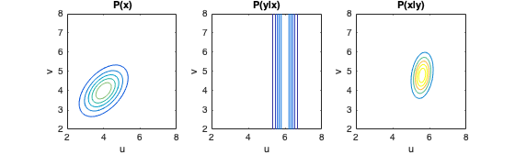
Bayes’ theorem: 2 variable example
How do you think the Posterior would change if the Prior was correlated?
When the Prior is correlated, observations of one variable can be used to update the analysis of both variables. This helps to ensure the analysis is physically realistic.

Slide 13
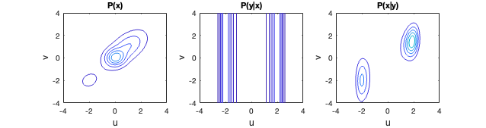

Bayes’ theorem: 2 variable example
In this example the prior is non-Gaussian. Let us observe $u^{2}$, how will this change the likelihood?
Ambiguity in the sign of u

Slide 14
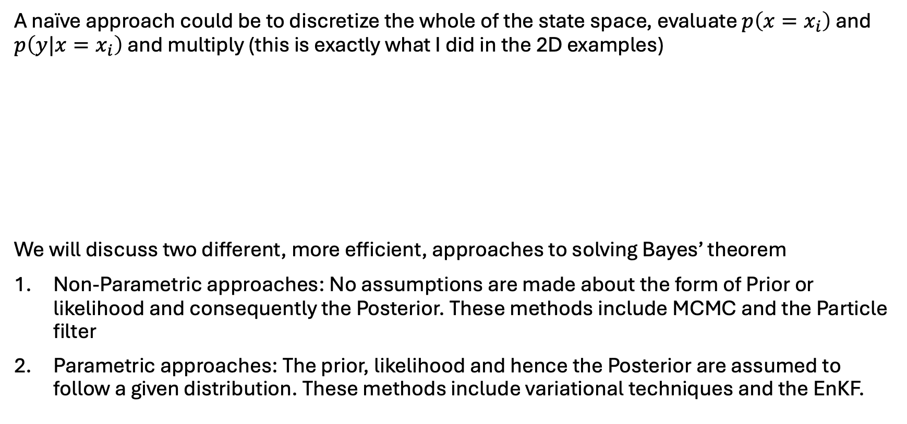
How to solve Bayes’ theorem?
A naïve approach could be to discretize the whole of the state space, evaluate $p\left({x=x}_{i}\right)$ and $p\left(y|x=x_{i}\right)$ and multiply (this is exactly what I did in the 2D examples)
We will discuss two different, more efficient, approaches to solving Bayes’ theorem
Non-Parametric approaches: No assumptions are made about the form of Prior or likelihood and consequently the Posterior. These methods include MCMC and the Particle filter
Parametric approaches: The prior, likelihood and hence the Posterior are assumed to follow a given distribution. These methods include variational techniques and the EnKF.
😟 Might miss the regions of high probability
😩 Waste effort evaluating the PDFs in regions of near-zero probability

Slide 15
Non-parametric approaches

Slide 16
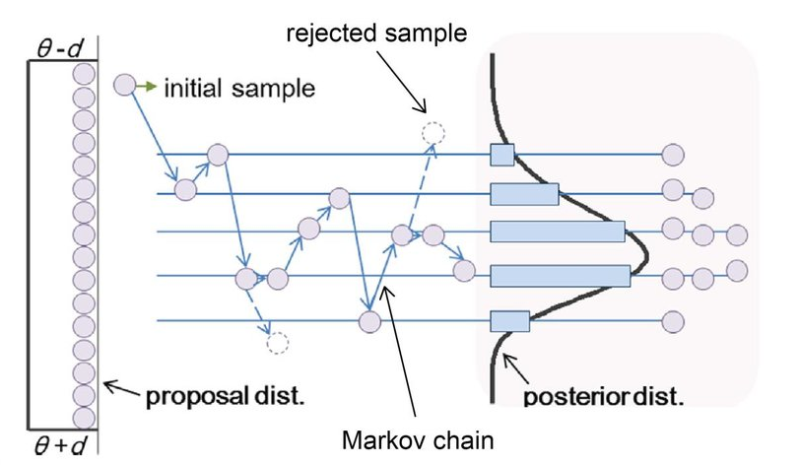
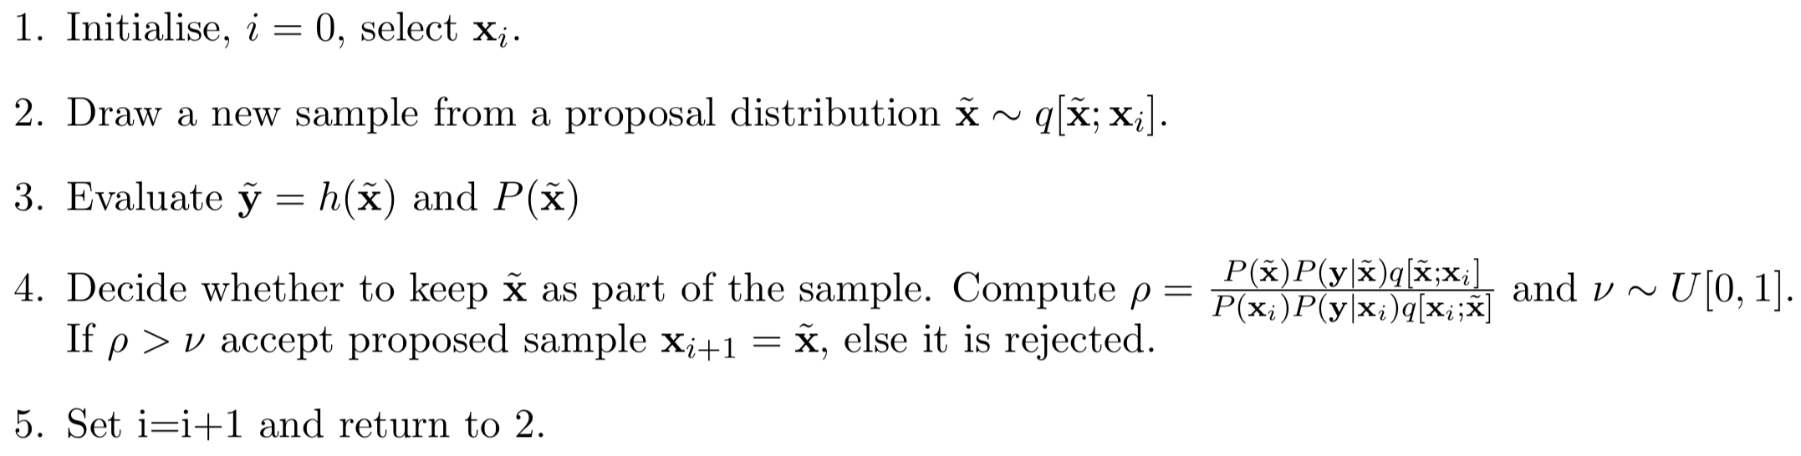

MCMC
Markov Chain Monte Carlo (MCMC) are a class of algorithms that allow you to sample from the Posterior distribution.
The basic algorithm is:

Slide 17
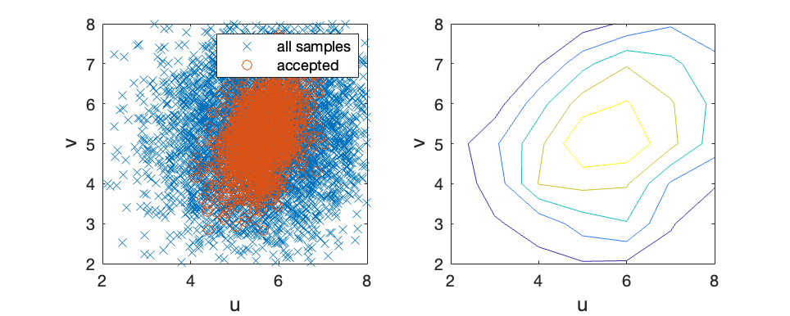
MCMC
The accept/reject procedure ensures that samples that provide a better fit to the observations are immediately accepted, those that provide a similar fit are considered, and those that lead to simulated observations that are very different from the measurements are rejected.
Regions with relatively high probability are therefore preferentially sampled, whereas regions with low probability are avoided, and a sample of the posterior distribution is produced using far fewer iterations than direct computation of the PDF.
The theoretical underpinnings of the MCMC algorithm can be found in Mosegaard and Tarantola(2002) and Tarantola (2005).

Slide 18
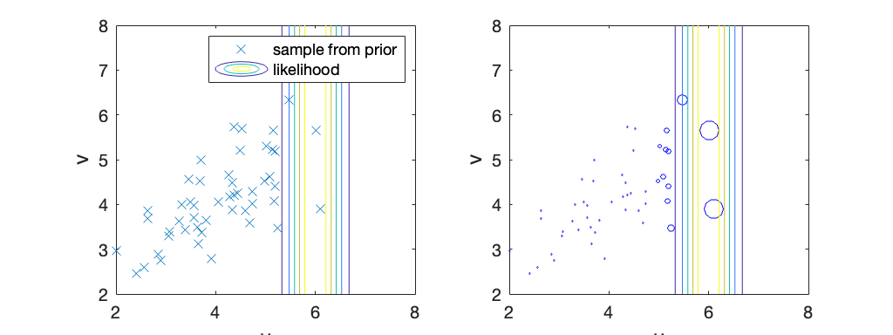
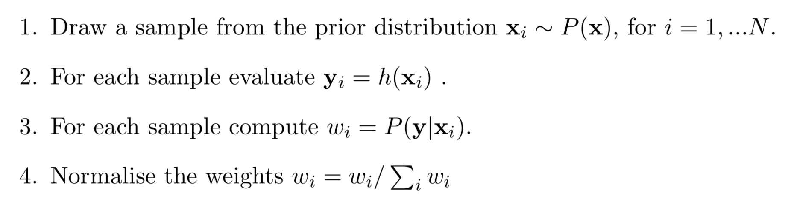
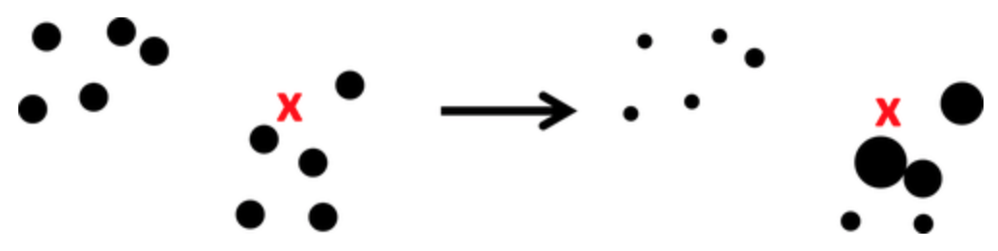
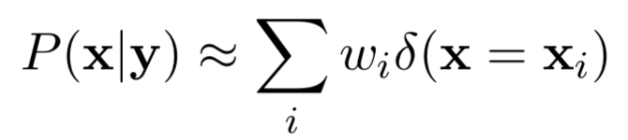
The Particle filter
Like the MCMC the Particle filter (PF, also known as sequential MC) aims to produce a sample representation of the posterior distribution.
The basic idea is:
The posterior is then given by
Prior sample
Posterior sample

Slide 19

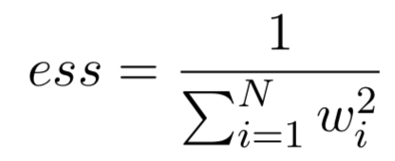
Application of Bayes’ to large problems
Non-parametric methods that make no assumption about the nature of the prior and the likelihood are inefficient for large-scale problems because the number of samples needed to represent the whole distribution grows exponentially with the size of the state to be estimated.
The efficiency of the MCMC method can be quantified by the acceptance/reject ratio (0.33 in the example).
The efficiency of the particle filter can be measured by the effective sample size:
If the weights are very uneven the ess can approach 1 and the weighted sample will be overwhelmed by sampling noise (4.7 with N=50 in the example).
To increase the ess, PFs are being developed to increase the chance that the sample is the region of high likelihood, see van Leeuwen et al. 2019.

Slide 20
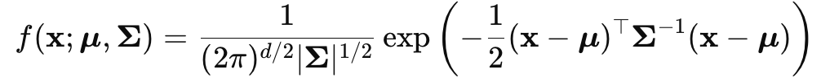
Parametric approaches - Gaussian assumption
In NWP we are interested in applying Bayes’ theorem to approximately 10⁸ dimensions.
In many cases, it is appropriate to assume that the prior and likelihood are Gaussian
Mean vector
Error covariance matrix

Slide 21

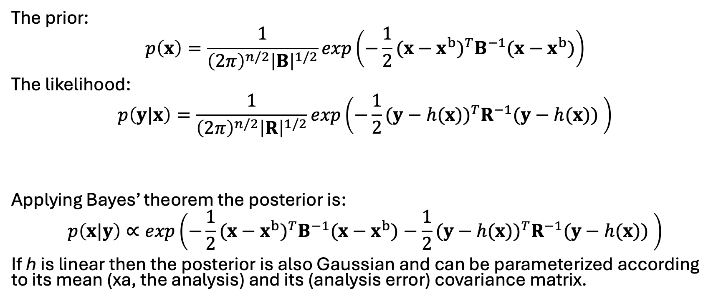
Gaussian assumption
Mean of the prior distribution
Prior error covariance matrix
The prior:
$$p\left(x\right)=\frac{1}{{\left(2π\right)}^{n/2}{\left|B\right|}^{1/2}}exp\left(−\frac{1}{2}{(x−x^{b})}^{T}B^{−1}(x−x^{b})\right)$$
The likelihood:
$$p\left(y|x\right)=\frac{1}{{\left(2π\right)}^{n/2}{\left|R\right|}^{1/2}}exp\left(−\frac{1}{2}{(y−h(x))}^{T}R^{−1}(y−h(x)) \right)$$
Applying Bayes’ theorem the posterior is:
$$p\left(x|y\right)∝exp\left(−\frac{1}{2}{(x−x^{b})}^{T}B^{−1}(x−x^{b})−\frac{1}{2}{(y−h(x))}^{T}R^{−1}(y−h(x)) \right)$$
If h is linear then the posterior is also Gaussian and can be parameterized according to its mean (xa, the analysis) and its (analysis error) covariance matrix.
Vector of observations
observation error covariance matrix
Observation operator, mapping from state to observation space
Notes:
The prior and posterior and conjugate distributions

Slide 22
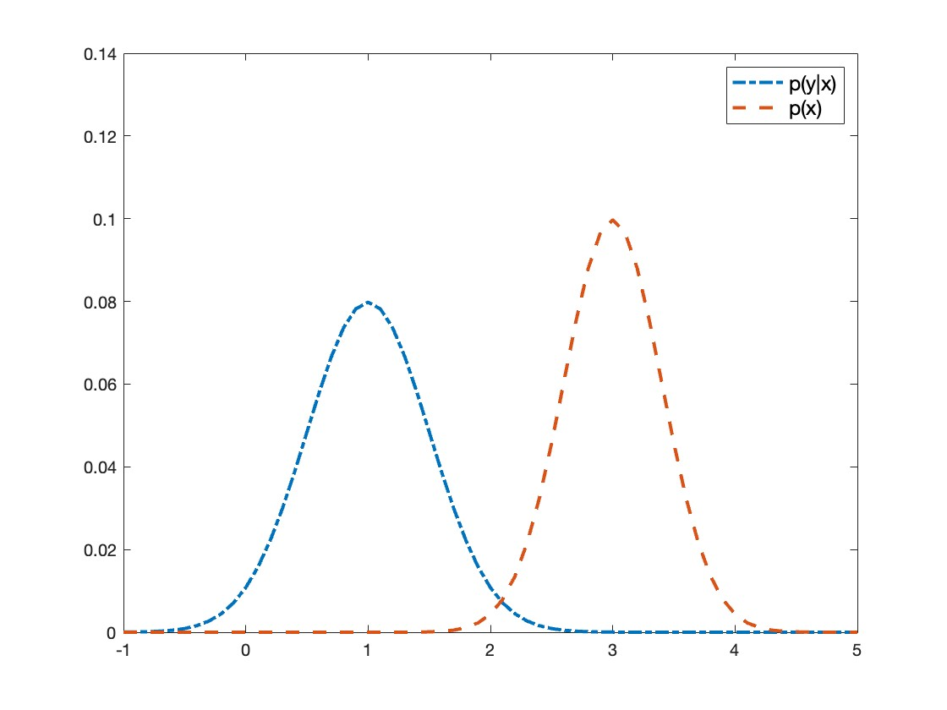


Bayes’ theorem scalar Gaussian illustration
The mean of p(y|x) and p(x) are the observed and background/forecast model values respectively.
The standard deviations of p(y|x) and p(x) are the uncertainties of the observed and background values respectively.
Innovation =$y−{h(x}^{b})$
e.g. temperature $°$C

Slide 23
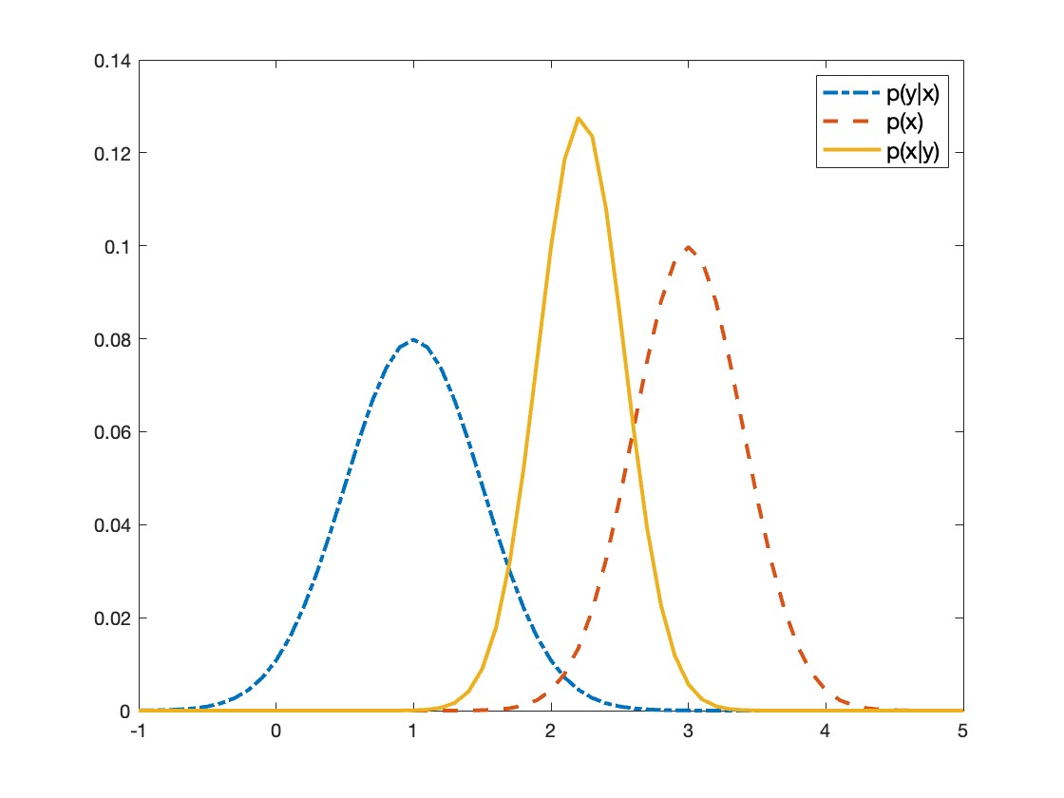
Bayes’ theorem scalar Gaussian illustration
The uncertainty of the posterior is smaller than either the likelihood or the prior.
The mean = mode of p(x|y) gives the ‘analysis’, which is also the minimum variance estimate!
Analysis increment

Slide 24
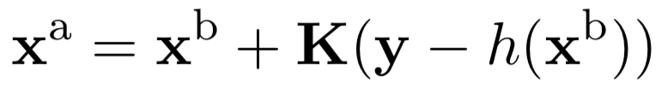
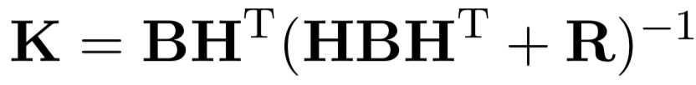

Analytical solution – the Kalman equations
The analysis (the maximum a posteriori state) can be derived analytically as
where
and H is the linearized observation operator.
K (known as the Kalman gain) prescribes the weight given to the observations versus the prior. We see that the K increases as the prior uncertainty (B) increases and the observation uncertainty (R) decreases.
The analysis error covariance can also be derived analytically
We see as K increases Pª decreases.
In practice, we can not evaluate these expressions directly.

Slide 25
Variational and Ensemble Kalman Filter techniques

Slide 26
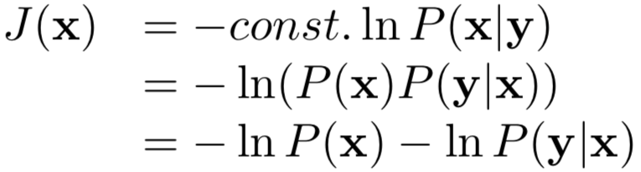
Variational (Var) DA
Var algorithms aim to find Maximum a-posterioiri (MAP) state/parameter set, which is also the mean of the Posterior distribution (assuming Gaussianity) and hence the same as the minimum variance estimate (Lorenc 1986).
In Var the analysis (the MAP estimate) is found by minimising the following cost function:
If the observation operator is linear then the cost function is quadratic
P (x|y) ~ N (xª , Pª)
P (x) ~ N (x^{b} , B)
P (y | x) ~ N (y , R)
J_{b} + J_{o}

Slide 27
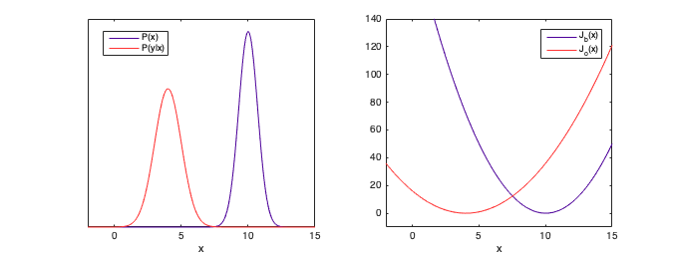
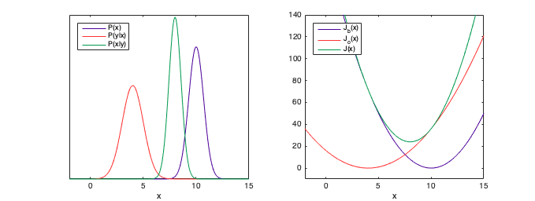
Variational DA
1 variable
Example:
The minimum of the cost function, xª, is known as the analysis.
y
xª
x^{b}
y
xª
x^{b}

Slide 28
The assimilation window (4DVar)
*Observations
background uncertainty, characterised by B
observation uncertainty, characterised by R
The general form of variational DA is called 4DVar. This allows for observations over a window to be assimilated.
The 4DVar cost function is:
Can think of as a generalized ob operator:
*
*
x^{b}
*
*
M(xª)
analysis uncertainty.
xª
*
t₀
Assimilation window
time
forecast

Slide 29
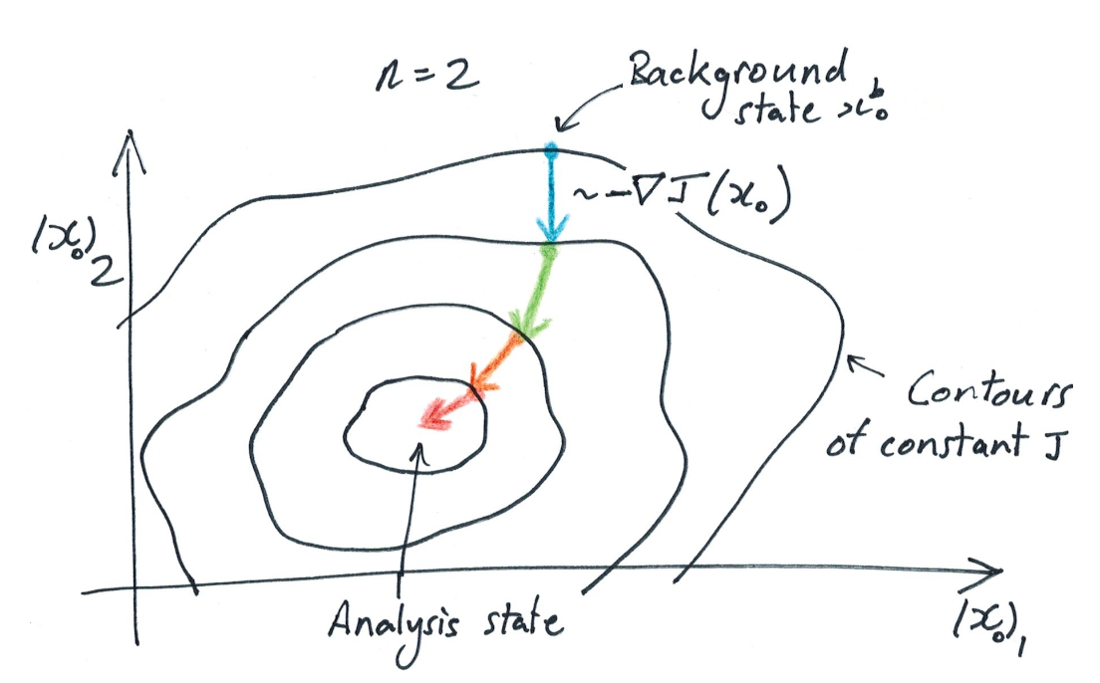
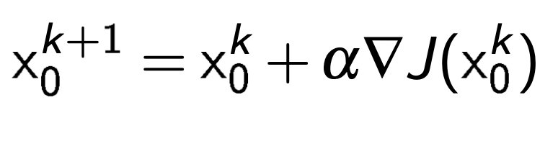
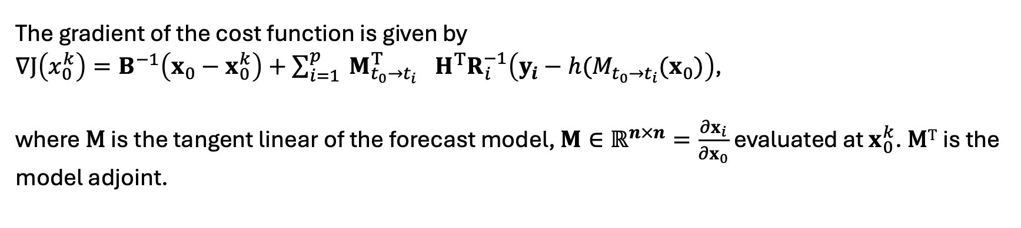
4DVar
The minimum of the cost function (the analysis) can be found iteratively by searching in the direction of the gradient
The gradient of the cost function is given by
$∇J\left(x_{0}^{k}\right)=B^{−1}\left(x_{0}−x_{0}^{k}\right)+\sum_{i=1}^{p}{{{{{ M}_{t_{0}→t_{i}}^{T}}_{}H}^{T}R}_{i}^{−1}\left(y_{i}−h(M_{t_{0}→t_{i}}(x_{0})\right)}$,
where M is the tangent linear of the forecast model, $M∈ℝ^{n×n}=\frac{∂x_{i}}{∂x_{0}}$ evaluated at $x_{0}^{k}$. M^{T} is the model adjoint.

Slide 30
An alternative approach
A major disadvantage of variational techniques is that B is generally not updated on each assimilation cycle. In variational DA B is only designed to represent a climatological estimate of the error covariances. However, the errors can be highly flow-dependent.
This has motivated the development of the Ensemble Kalman Filter (EnKF).
The EnKF also based on linear/Gaussian theory so is a retractable method for large systems.
Unlike Var the EnKF represents B using an ensemble (and calls it P^{f}).

Slide 31
The ensemble Kalman filter (EnKF)
The EnKF (Evensen 1994) merges KF theory with Monte Carlo estimation methods
Prediction step.
Posterior -> Prior
*
*
x_{b}
*
*
Update step.
Prior -> Posterior
*
Update step.
Prior -> Posterior
time

Slide 32

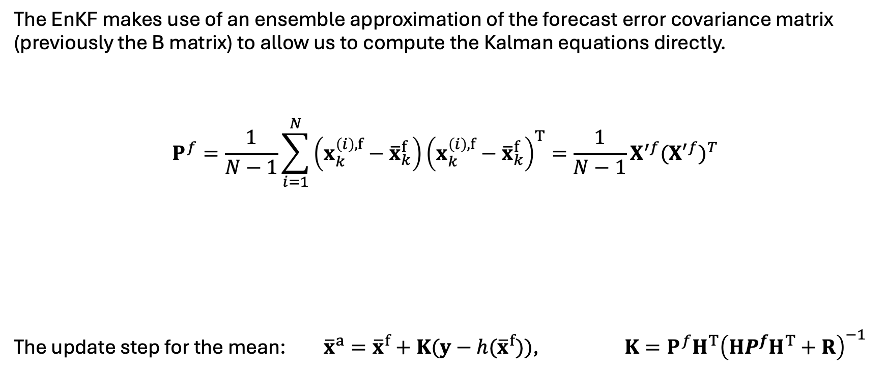
The ensemble Kalman filter (EnKF)
The EnKF makes use of an ensemble approximation of the forecast error covariance matrix (previously the B matrix) to allow us to compute the Kalman equations directly.
$$P^{f}=\frac{1}{N−1}\sum_{i=1}^{N}{\left(x_{k}^{\left(i\right),f}−{\overline{x}}_{k}^{f}\right)}{\left(x_{k}^{\left(i\right),f}−{\overline{x}}_{k}^{f}\right)}^{T}=\frac{1}{N−1}X^{′f}{({X′}^{f})}^{T}$$
The update step for the mean: ${\overline{x}}^{a}={\overline{x}}^{f}+K(y−h({\overline{x}}^{f}))$, $K=P^{f}H^{T}{\left(HP^{f}H^{T}+R\right)}^{−1}$
Forecast perturbation matrix . Dimension $n×N$
Number of ensemble members

Slide 33
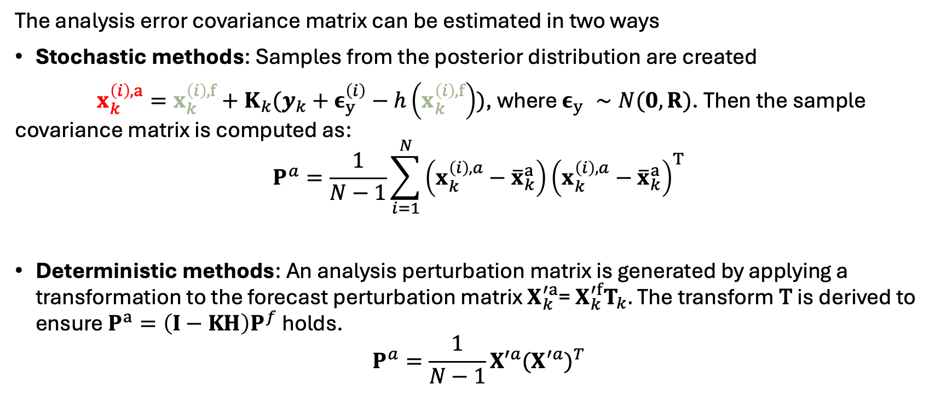
EnKF – the update step for the covariance
The analysis error covariance matrix can be estimated in two ways
Stochastic methods: Samples from the posterior distribution are created
$x_{k}^{\left(i\right),a}=x_{k}^{\left(i\right),f}+K_{k}(y_{k}+ε_{y}^{\left(i\right)}−h\left(x_{k}^{\left(i\right),f}\right))$, where $ε_{y}^{}∼N(0,R)$. Then the sample covariance matrix is computed as:
$$P^{a}=\frac{1}{N−1}\sum_{i=1}^{N}{\left(x_{k}^{\left(i\right),a}−{\overline{x}}_{k}^{a}\right)}{\left(x_{k}^{\left(i\right),a}−{\overline{x}}_{k}^{a}\right)}^{T}$$
Deterministic methods: An analysis perturbation matrix is generated by applying a transformation to the forecast perturbation matrix $X_{k}^{′a}$= $X_{k}^{′f}T_{k}.$The transform T is derived to ensure $P^{a}=\left(I−KH\right)P^{f}$ holds.
$$P^{a}=\frac{1}{N−1}{X′}^{a}{(X^{′a})}^{T}$$

Slide 34


EnKF and Sample errors
Because the ensemble size is limited, $N≪n$. This means that the ensemble estimate of $P^{f}$ will be low rank and affected by sample errors.
The sample errors will affect
  The estimate of the error variances so that the wrong weight is given to the observations. When the the error variances are underestimated this can lead to filter divergence!!!!
  The error correlations such that observations can update variables which they do not contain information about.

Slide 35

EnKF and Sample errors
To mitigate these two problems, we use a combination of
variance inflation (e.g. Mitchell and Houtekamer, 2000; Anderson and Anderson, 1999, Whitaker and Hamill, 2012) and
covariance localization (Houtekamer and Mitchell, 2001, Hunt et al. 2007).

Slide 36
Summary
There are many different data assimilation algorithms proposed. The ones presented all aim to solve Bayes’ theorem to find the probability distribution of the state consistent with the uncertainty in the observations and model.
Many methods used operationally rely on the Gaussian assumption to make the DA problem tractable for large dimensions and efficient to run as part of a cycled forecasting system.
These methods include the variational and Ensemble Kalman Filter techniques.

Slide 37
Summary
However, there are many reasons why the Gaussian assumption may not hold:
  Non-linear model
  Non-linear observation operator
  Non-Gaussian errors e.g. if the variable is bounded
Assuming Gaussianity in these cases can result in:
  High probabilities assigned to unphysical states that may result in numerical instabilities
  Low probabilities assigned to important regimes
  Extreme events not represented
Even within Var and EnKF, there is room for the relaxation of the Gaussian assumption e.g. inner/outer loops, Gaussian anamorphosis.
Can reformulate the problem to not make Gaussian assumptions e.g. the particle filter.

Slide 38
A note on parameter estimation
Each of the DA methods can be modified to estimate parameters instead of (or as well as) estimating the initial state. For example,
Model parameters describing physical processes
Parameters to describe the bias correction of the model or observations
Need to consider
How the prior uncertainty is represented. If you updating the parameters using variational or EnKF methods, does a Gaussian error make sense?
How can the observations be related to these parameters? Often, you do not observe parameters directly, so instead rely on their errors being correlated with state variables that are observed.

Slide 39
DA software
On Wednesday and Thursday we will dedicate more time to learning about Variational and EnKF algorithms with computer practicals.
Our code is available on https://github.com/darc-reading/darc-training-2025/
Tomorrow Yumeng and Chris will give a lecture DA software packages

Slide 40



Schematic comparison of techniques
MCMC
Direct computation
Particle Filter
Variational
EnKF
Can combine the best bits of (hybridise) the different algorithms

Slide 41
References
Mosegaard and Tarantola (2002): Probabilistic Approach to Inverse Problems. International Geophysics
Tarantola (2005): Inverse problem theory and methods for model parameter estimation. SIAM
van Leeuwen et al. (2019): Particle filters for high-dimensional geoscience applications: A review. Q J R Meteorol Soc.
Lorenc (1986): Analysis methods for numerical weather prediction. Q.J.R. Meteorol. Soc
Evensen (1994): Sequential data assimilation with a nonlinear quasi-geostrophic model using Monte Carlo methods to forecast error statistics, J. Geophys. Res.
Mitchell and Houtekamer, (2000): An Adaptive Ensemble Kalman Filter. Mon. Wea. Rev.
Anderson and Anderson, (1999): A Monte Carlo Implementation of the Nonlinear Filtering Problem to Produce Ensemble Assimilations and Forecasts. Mon. Wea. Rev.
Whitaker and Hamill, (2012) Evaluating Methods to Account for System Errors in Ensemble Data Assimilation. Mon. Wea. Rev.
Houtekamer and Mitchell, (2001): A Sequential Ensemble Kalman Filter for Atmospheric Data Assimilation. Mon. Wea. Rev.
Hunt et al. (2007): Efficient data assimilation for spatiotemporal chaos: A local ensemble transform Kalman filter, Physica D: Nonlinear Phenomena

